Slide 1
Actor Model

Slide 2
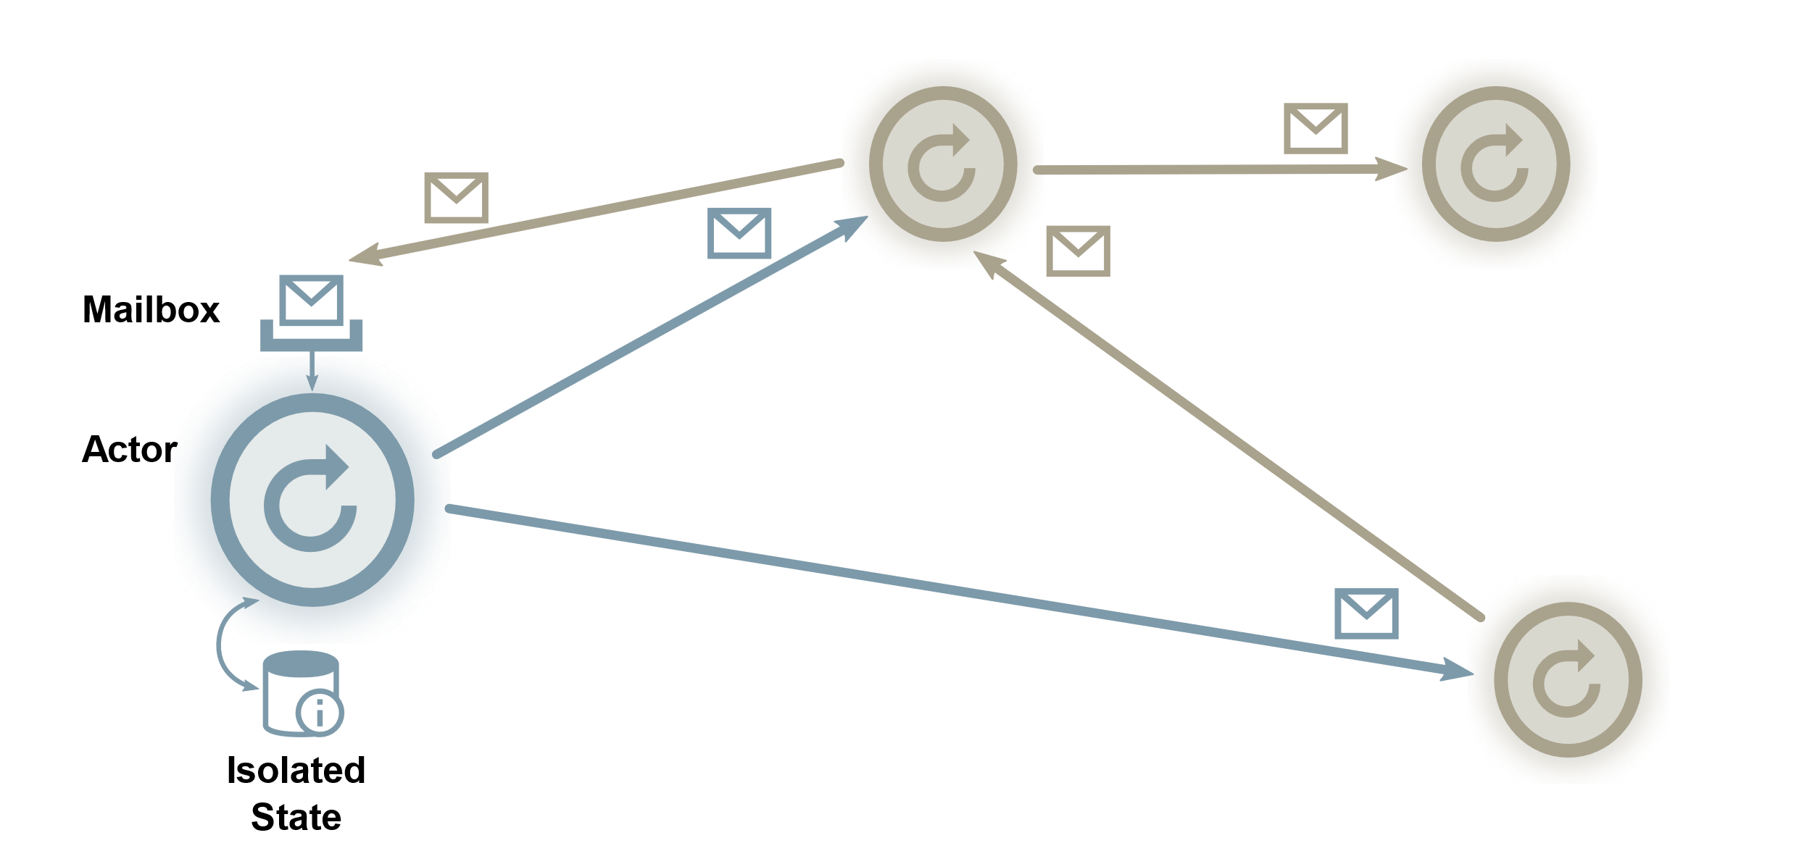
https://berb.github.io/diploma-thesis/original/054_actors.html

Slide 3
Original proposal of the actor model
They can send messages asynchronously to one another, and,
They have a mailbox which contains messages that they have received, allowing messages to be received at any time and then queued for processing.
Messages are of the form:
(request: <message-to-target>, reply-to: <reference-to-messenger>)

Slide 4
Fault-tolerant operations
Isolated processes
Pure message passing between processes
Detection of errors in remote processes
The ability to determine what type of error caused a process crash

Slide 5
Reference
https://www.youtube.com/watch?v=YTQeJegJnbo
http://dist-prog-book.com/chapter/3/message-passing.html
https://horstmann.com/unblog/2023-06-27/index.html
https://speakerdeck.com/matteobertozzi/java-21-virtual-threads

